Slide 1
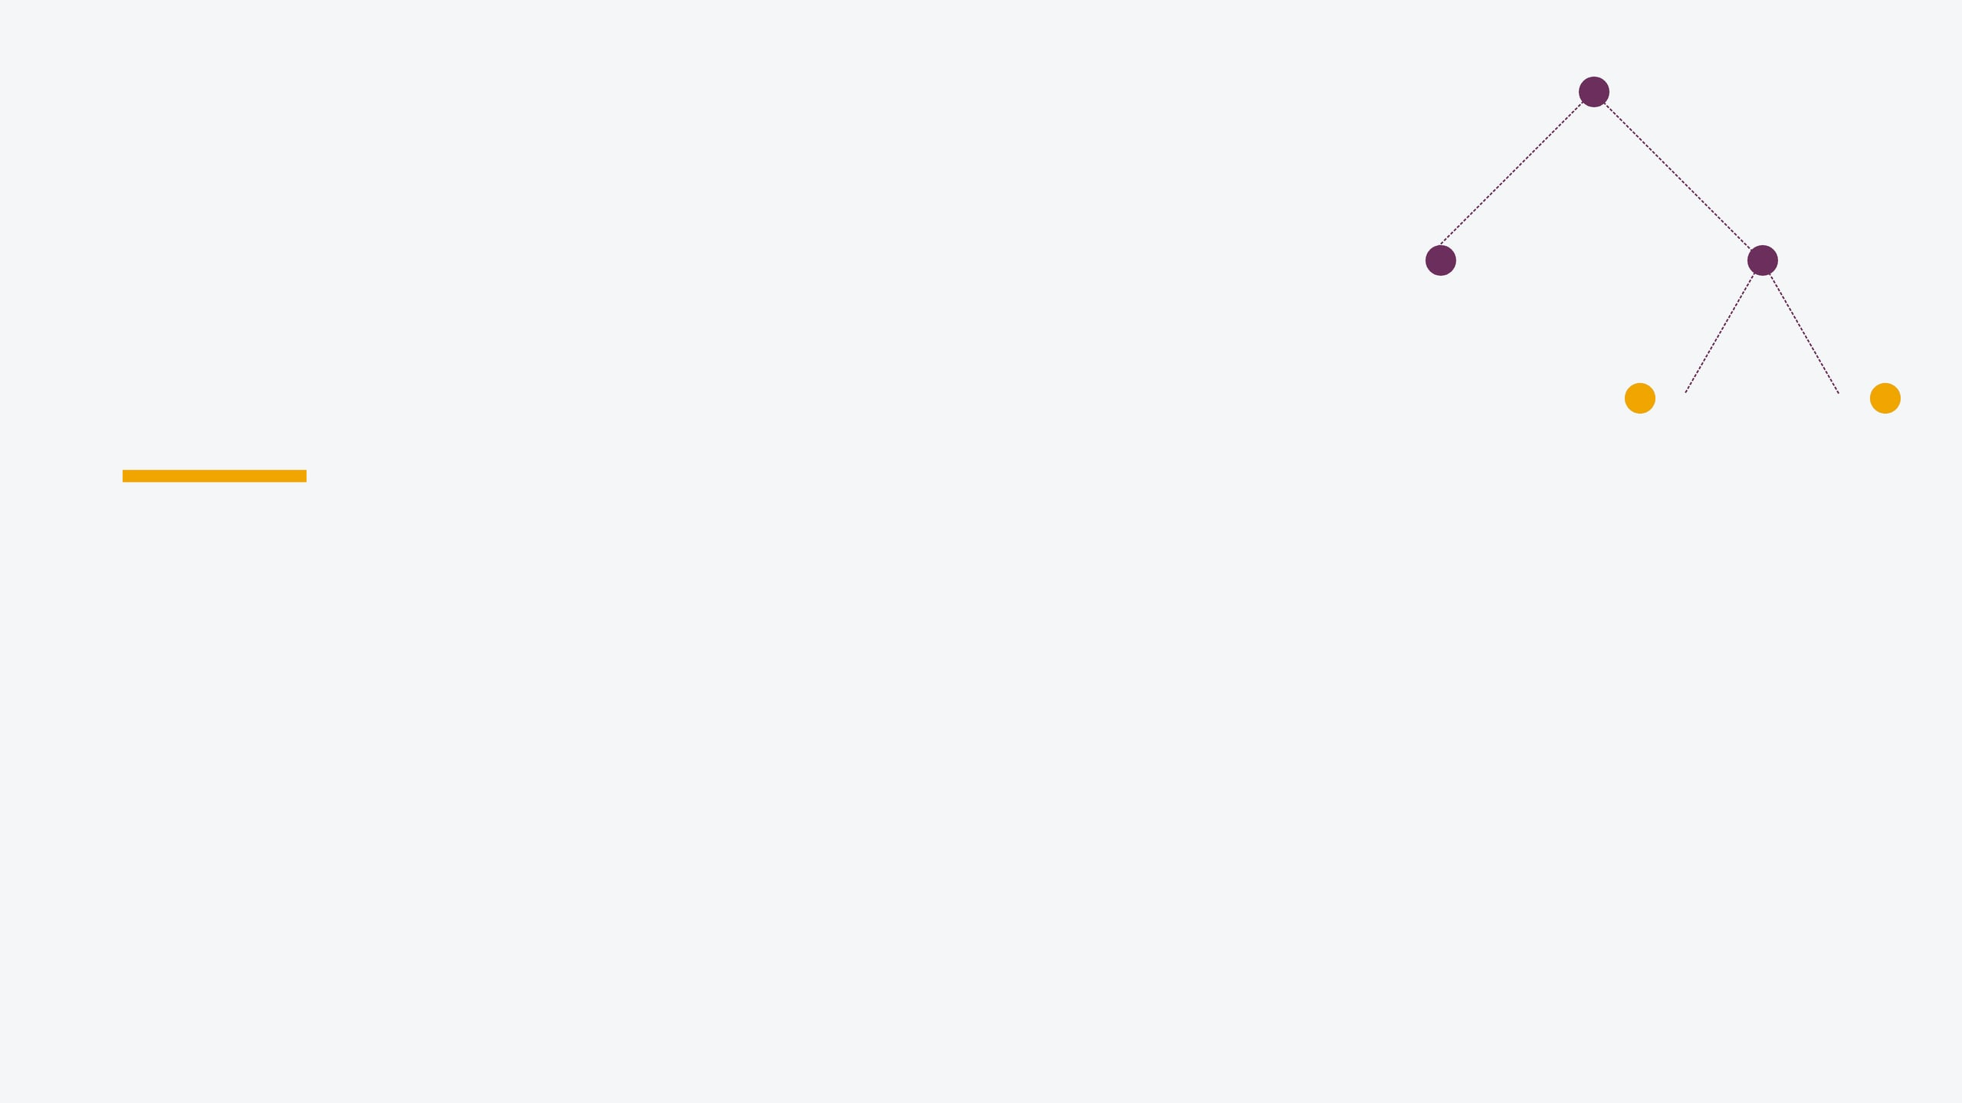
Mastering Decision Trees in Machine Learning
From Fundamental Concepts to Practical Implementation
By – Miraj Deep Bhandari

Slide 2
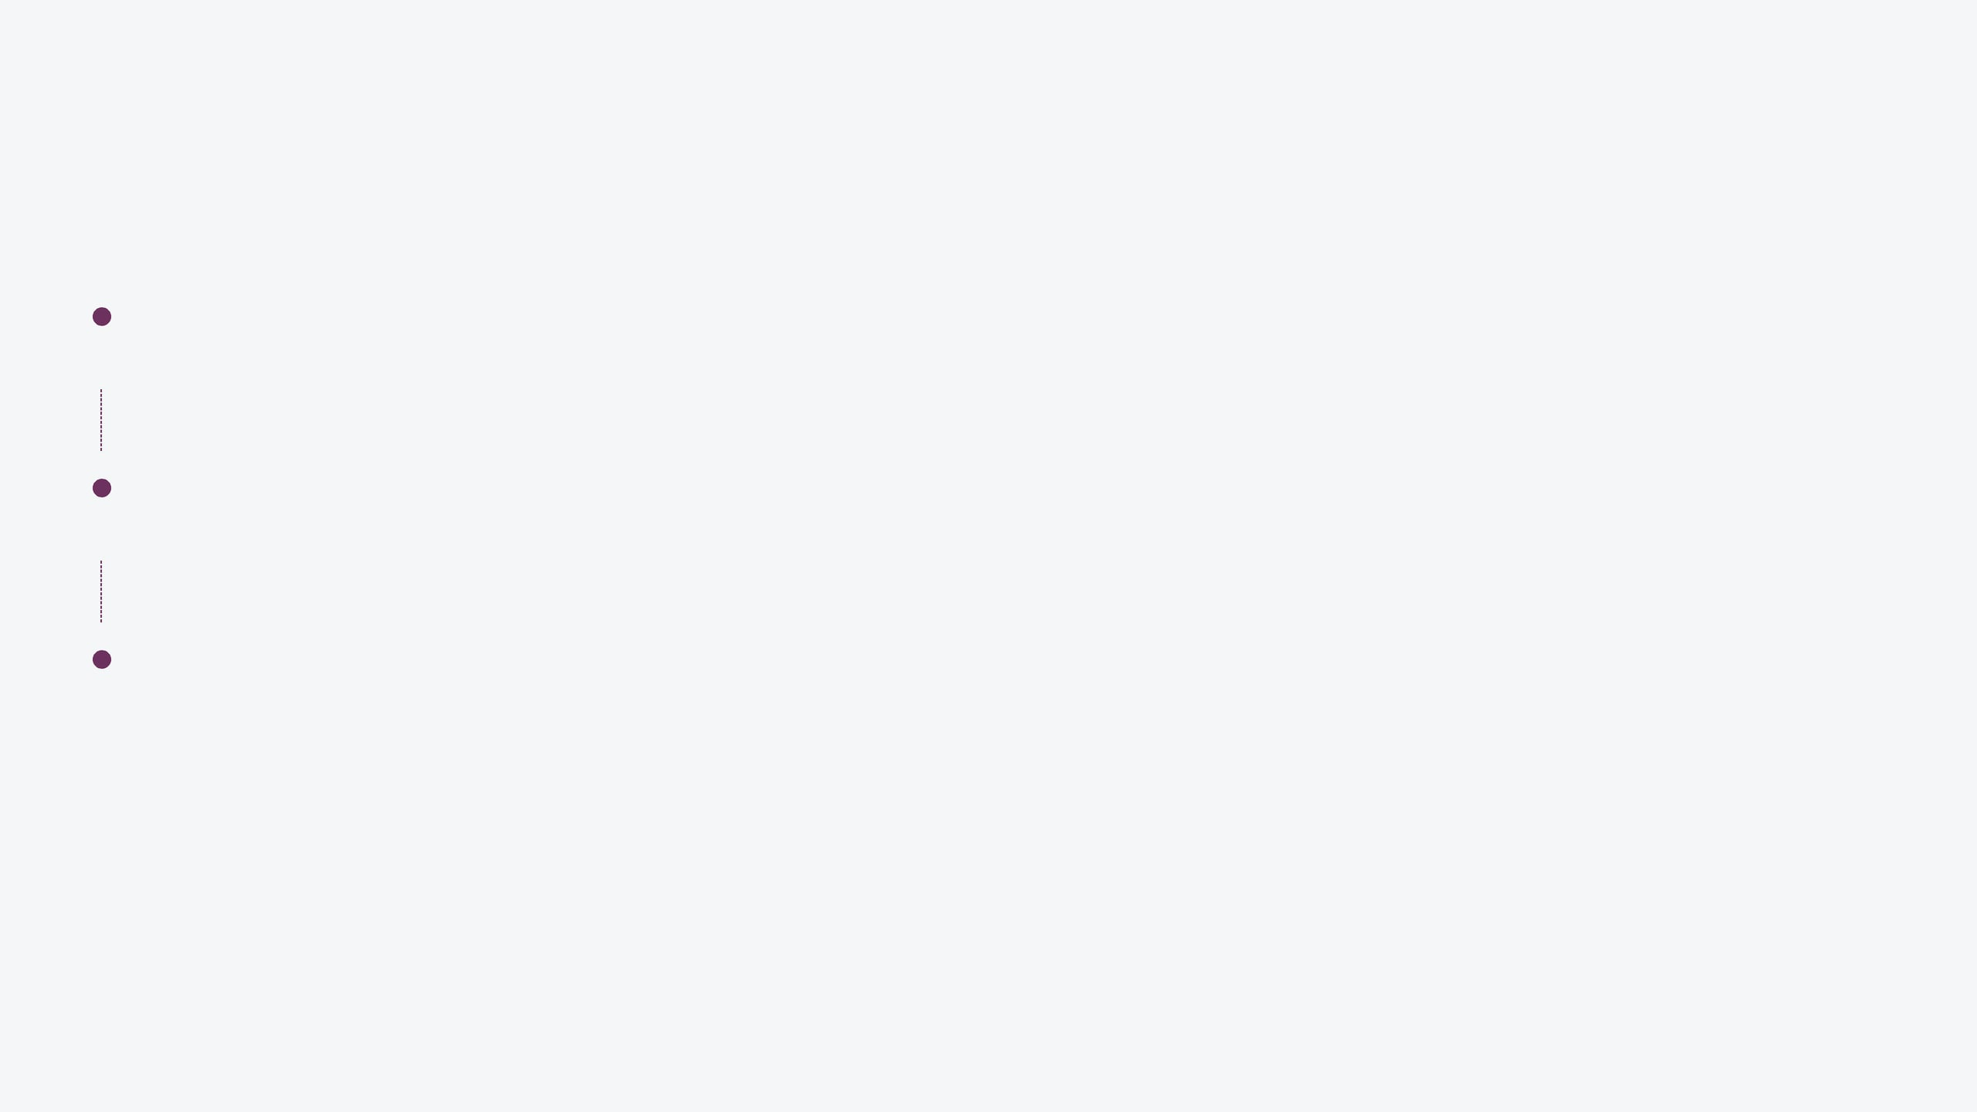
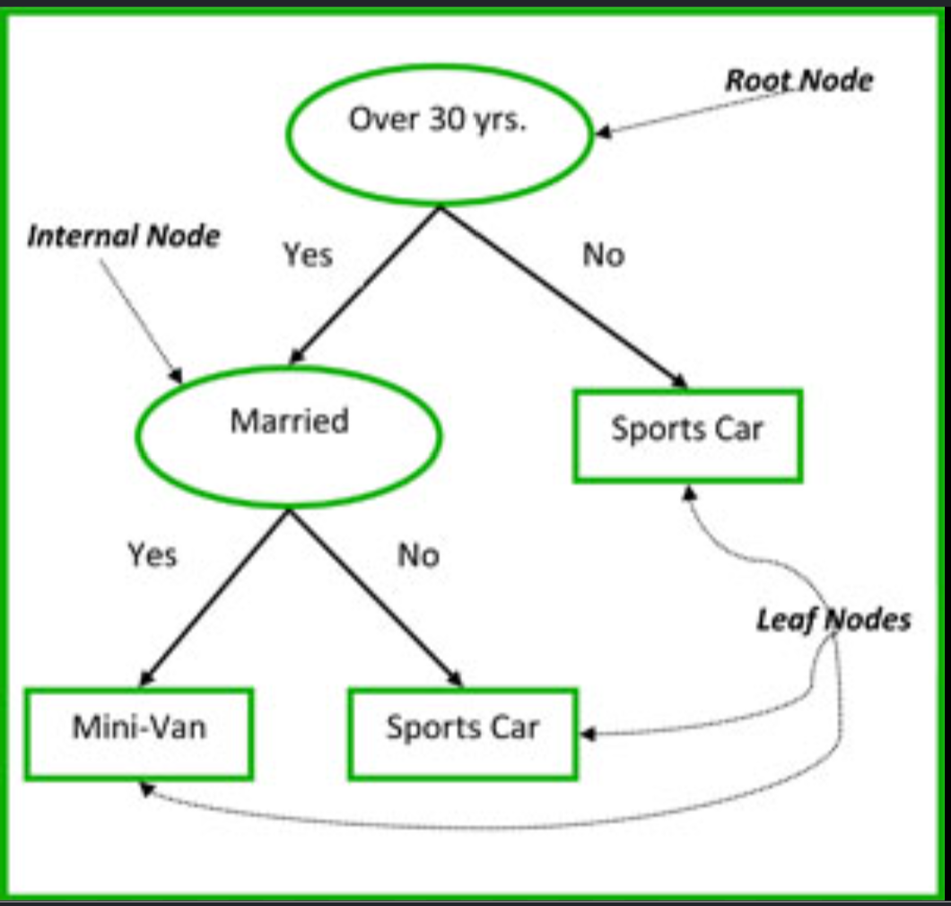
A Decision Tree mimics human decision-making through a hierarchical structure.
"Think of it as a flowchart where every path leads to a specific conclusion."
Root Node: The starting point representing the entire dataset.
Internal Nodes: Decision points based on specific feature thresholds.
Leaf Nodes: Terminal points that provide the final output.
What is a Decision Tree?

Slide 3

Algorithms use mathematical measures to determine the most "informative" split.
Entropy Formula:
H(S) = - ∑ P
_{i}
log
₂
(P
_{i}
)
Entropy: A measure of disorder or impurity in a dataset
Range: 0 (Pure) to 1 (Maximum Impurity)
Information Gain: The reduction in entropy achieved after splitting the data. A high Information Gain means that the feature creates purer subsets after the split.
Selection: The feature with the highest Information Gain is chosen for the node split.
Example
Suppose you're choosing between two features to split a dataset:
Feature A separates the data into almost all Yes and all No groups.
Feature B creates groups that still contain a mix of Yes and No.
Then:
Feature A → High Information Gain (low impurity after the split)
Feature B → Low Information Gain (high impurity after the split)
Measuring Purity: Entropy & Information Gain

Slide 4
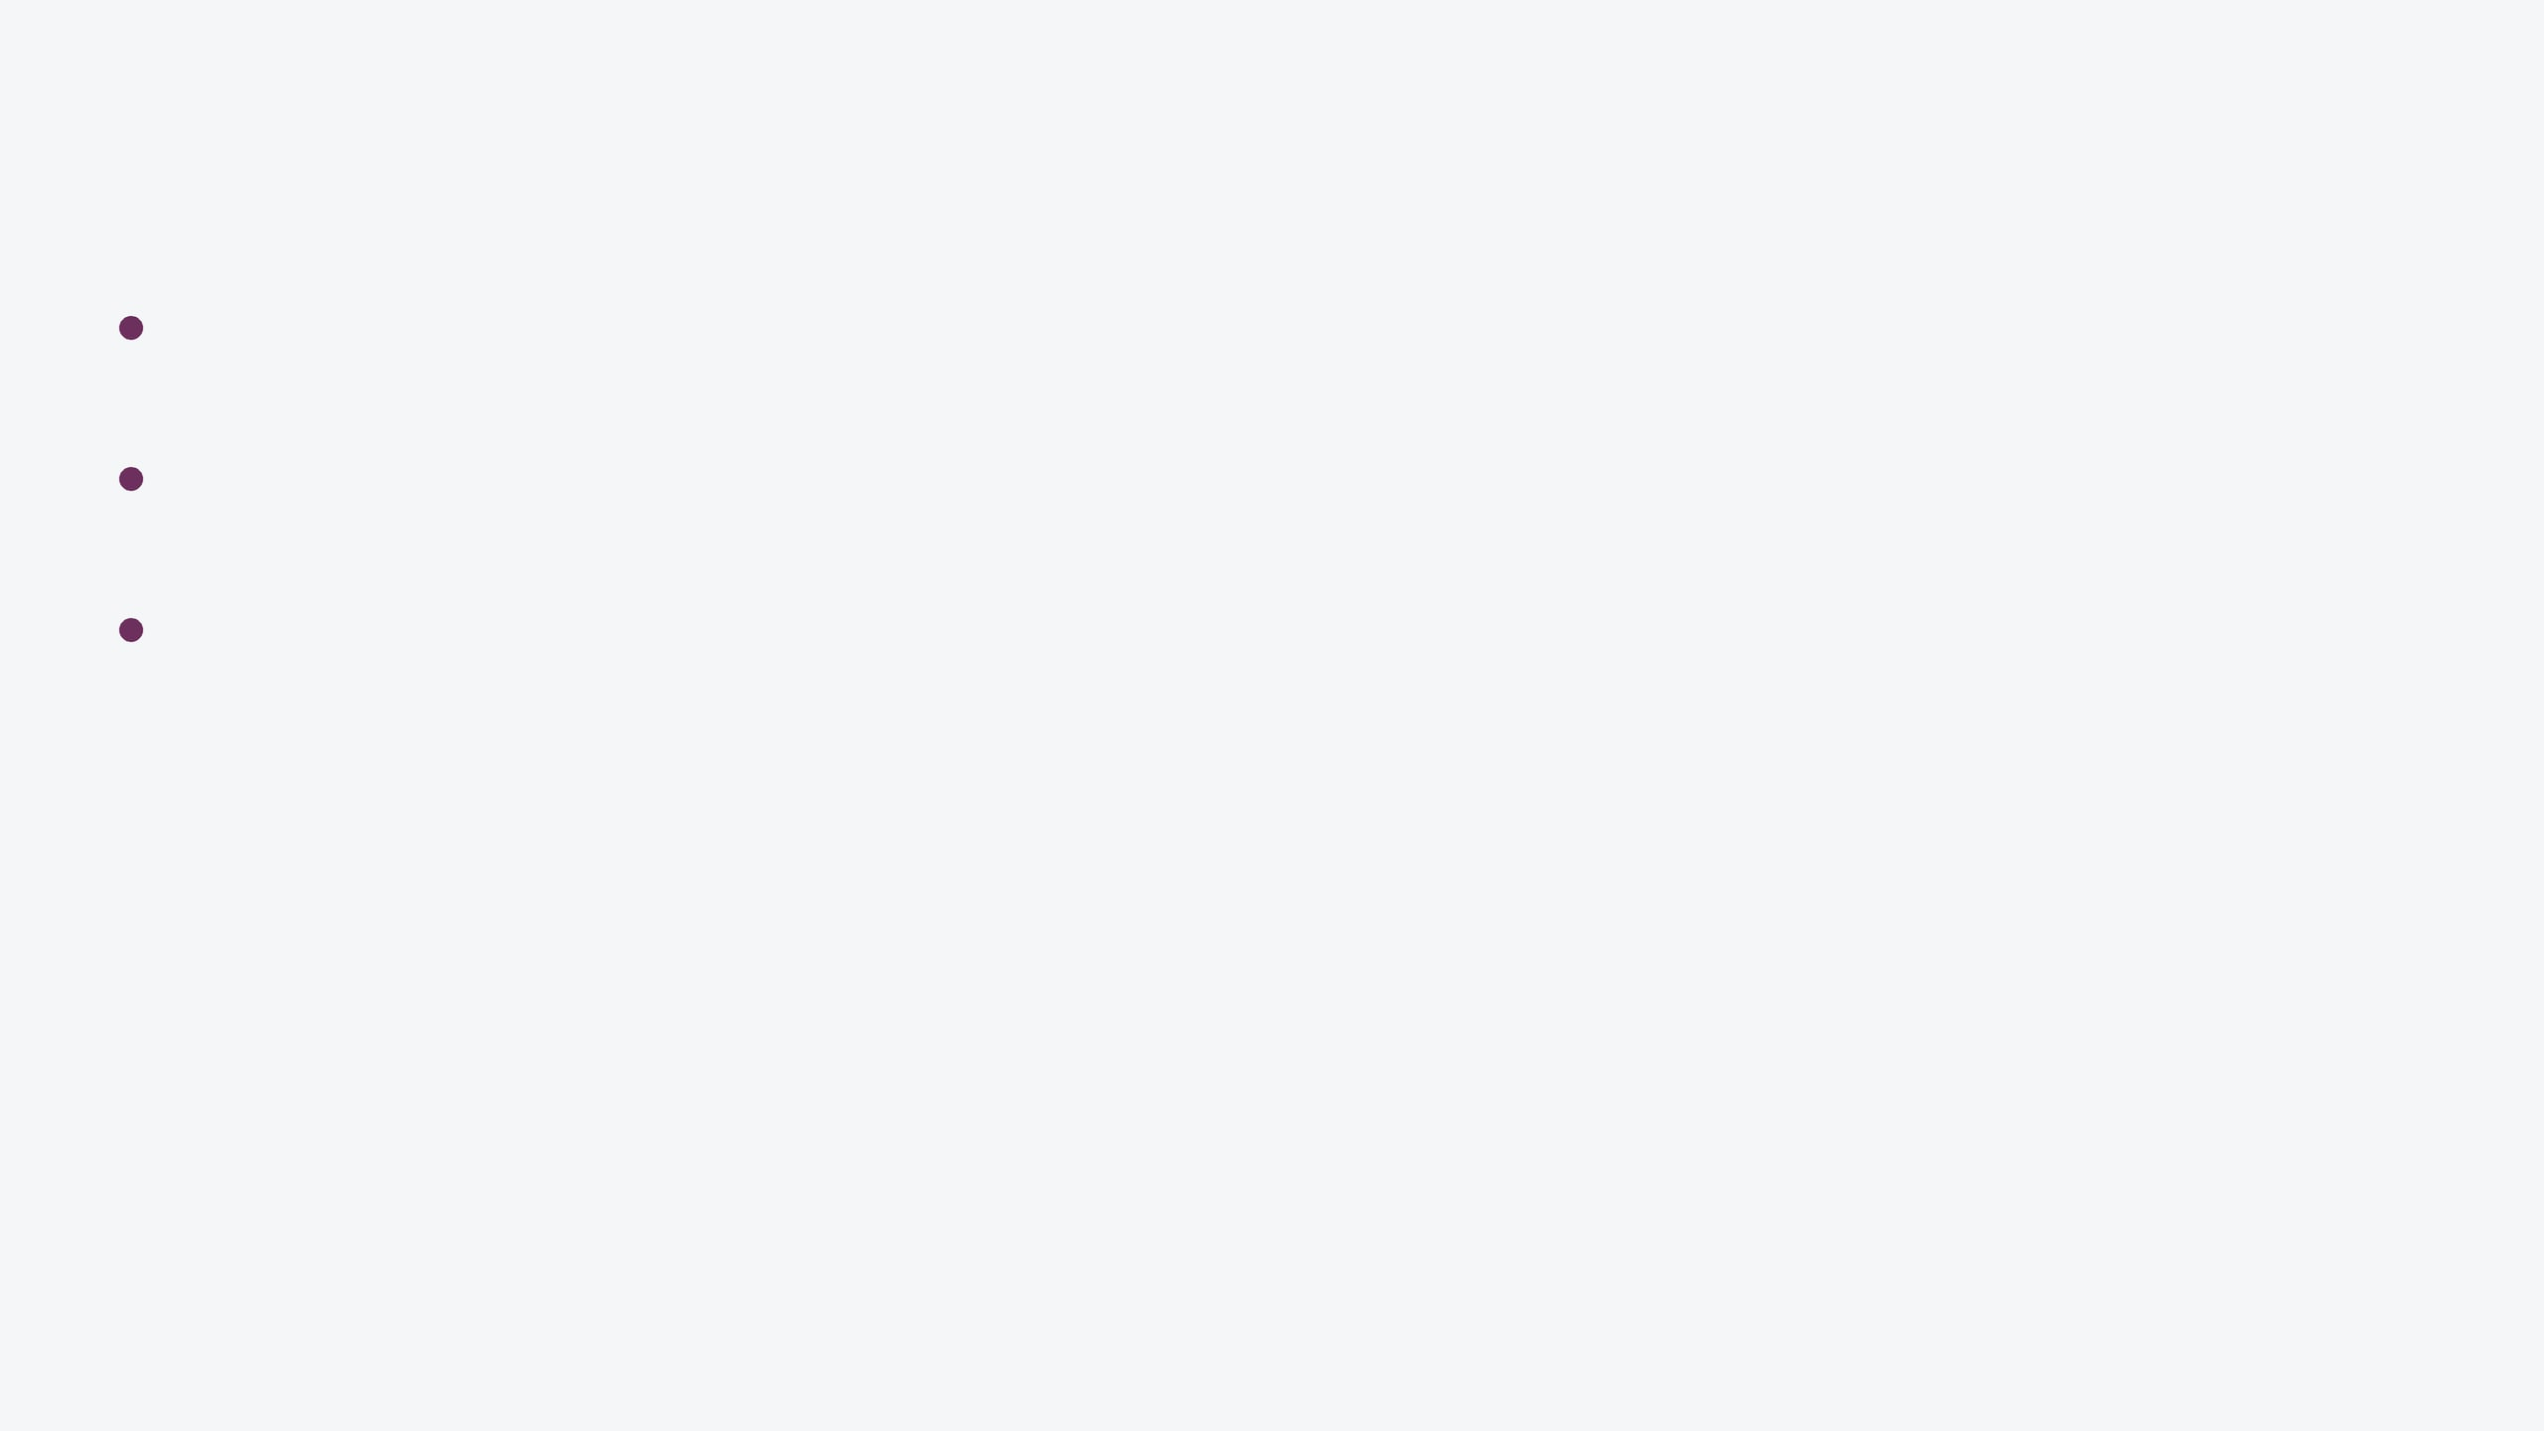
Gini Impurity is the default metric in Scikit-learn due to its computational efficiency.
GINI FORMULA:
G.I. = 1 - ∑ (P
)
²
Definition: A measure of impurity or the probability of misclassification in a dataset.
_{i}
Efficiency: Unlike Entropy, Gini avoids logarithmic calculations, making it faster for large datasets.
Where P
_{i}
is the probability of class i
Comparison: Both metrics usually lead to similar tree structures, but Gini is optimized for performance.
"Gini is often preferred when computational resources or speed are primary concerns."
Gini Impurity: The Efficient Alternative

Slide 5
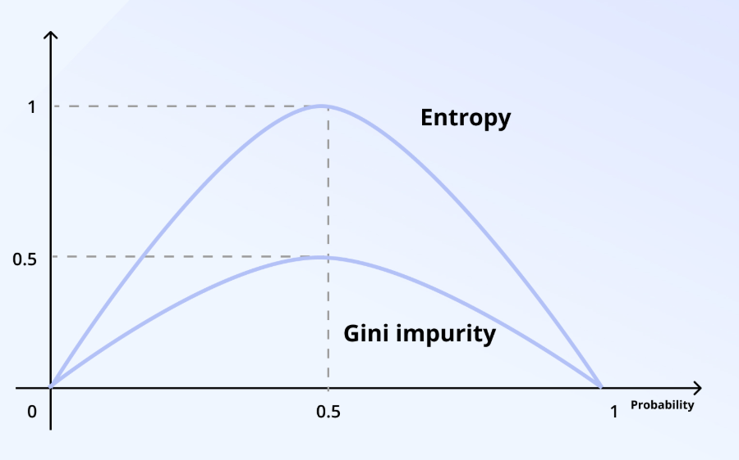
Entropy vs Probability Graph:

Slide 6

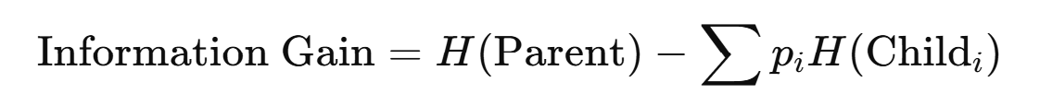
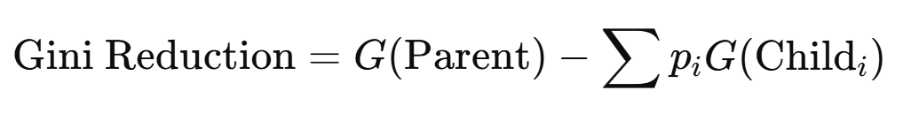
A decision tree can split nodes using either Entropy (Information Gain) or Gini Impurity, depending on the algorithm used.
Information gain:
ID3 uses Entropy and Information Gain.
Gini Reduction:
CART uses Gini Impurity and Gini Reduction.
We will see how ID3 works in this slide. CART also works similarly to ID3, only the formula is different.
Different Trees Algorithms

Slide 7
Decision Trees :
Intution

Slide 8
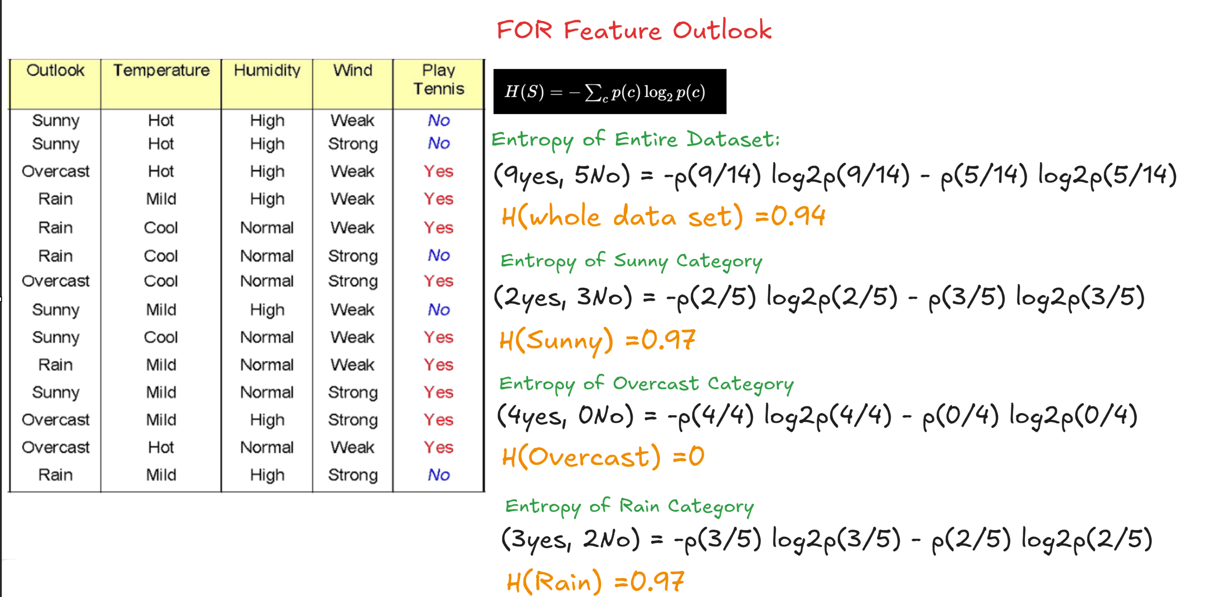

Slide 9
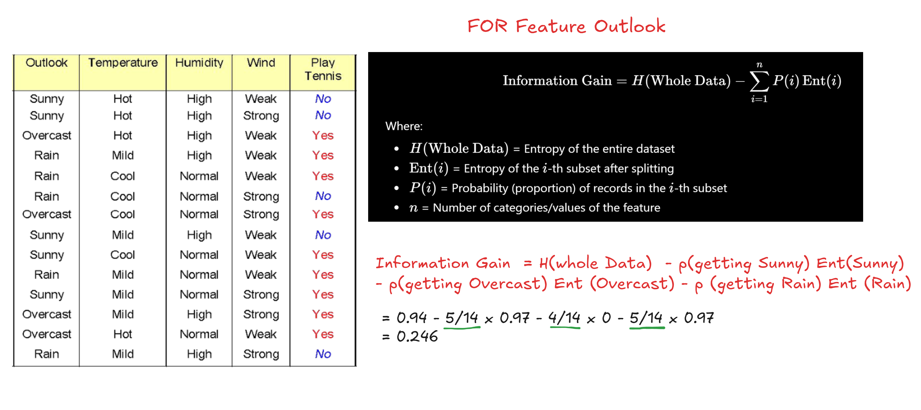

Slide 10
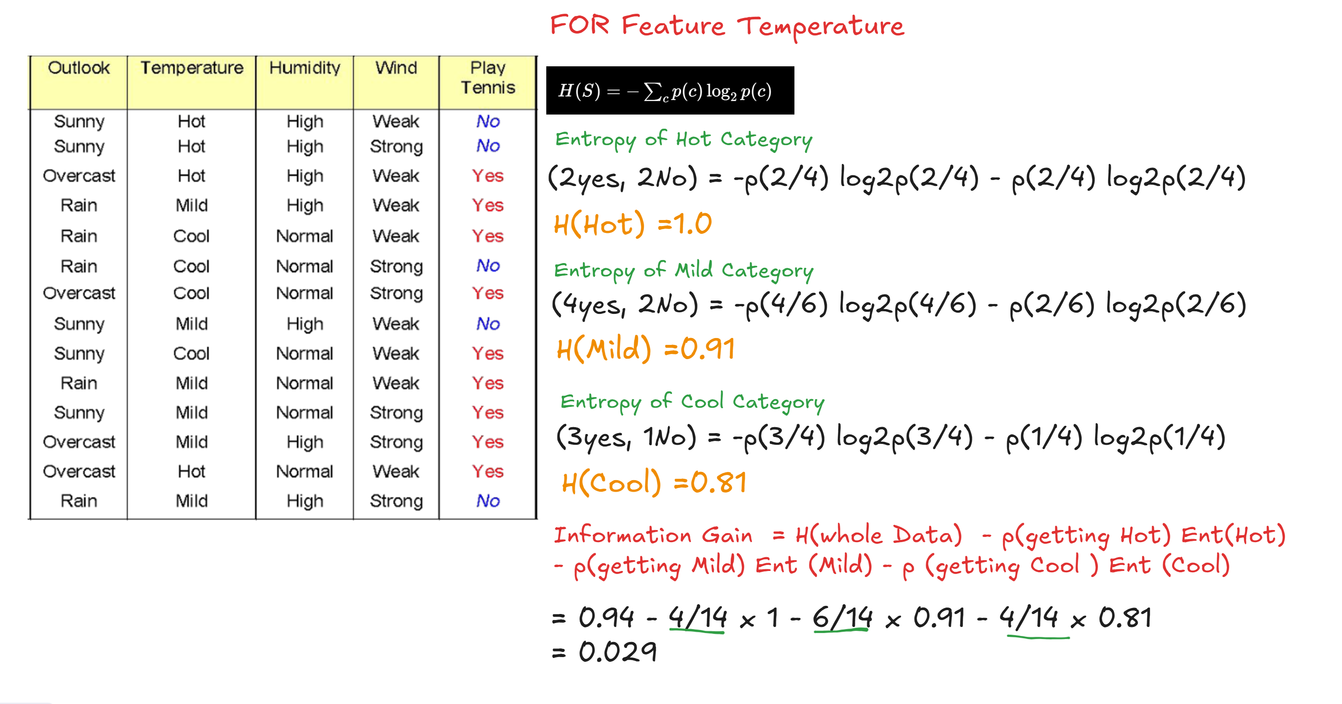

Slide 11
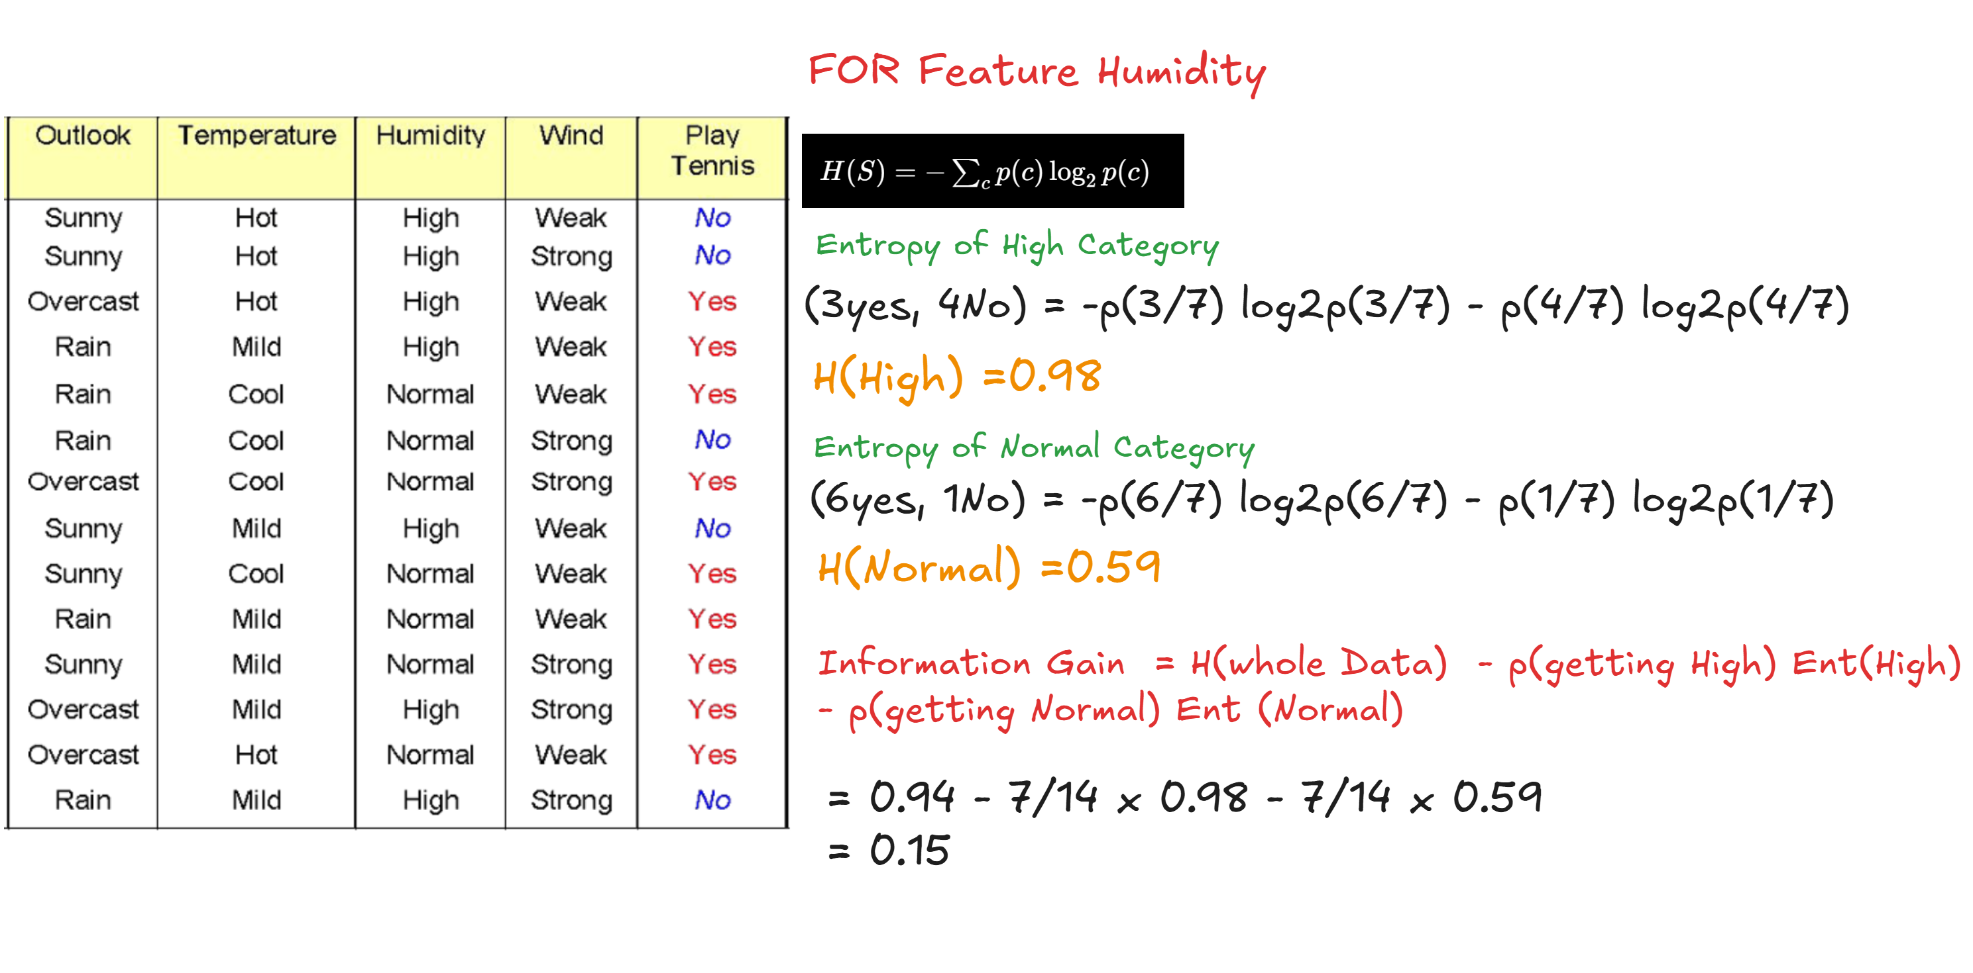

Slide 12
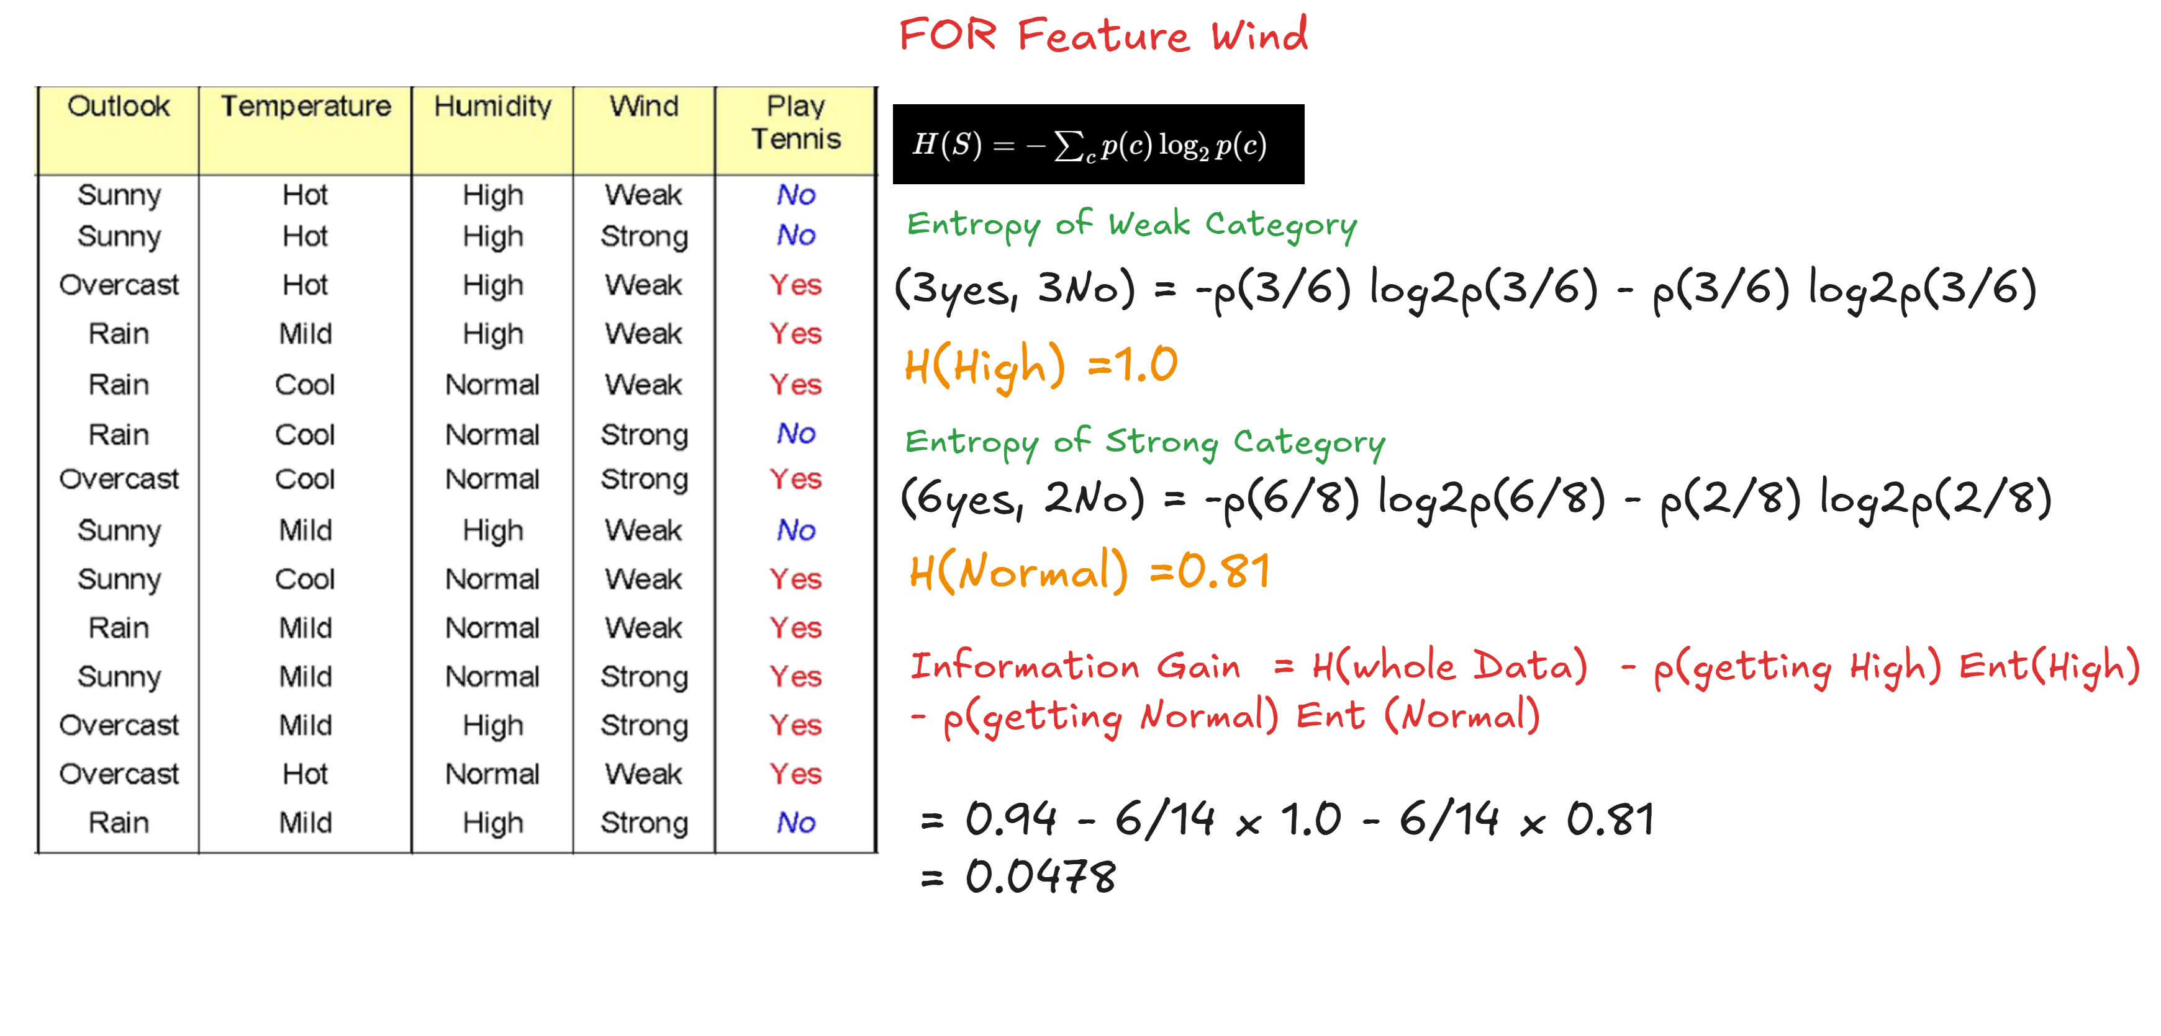

Slide 13
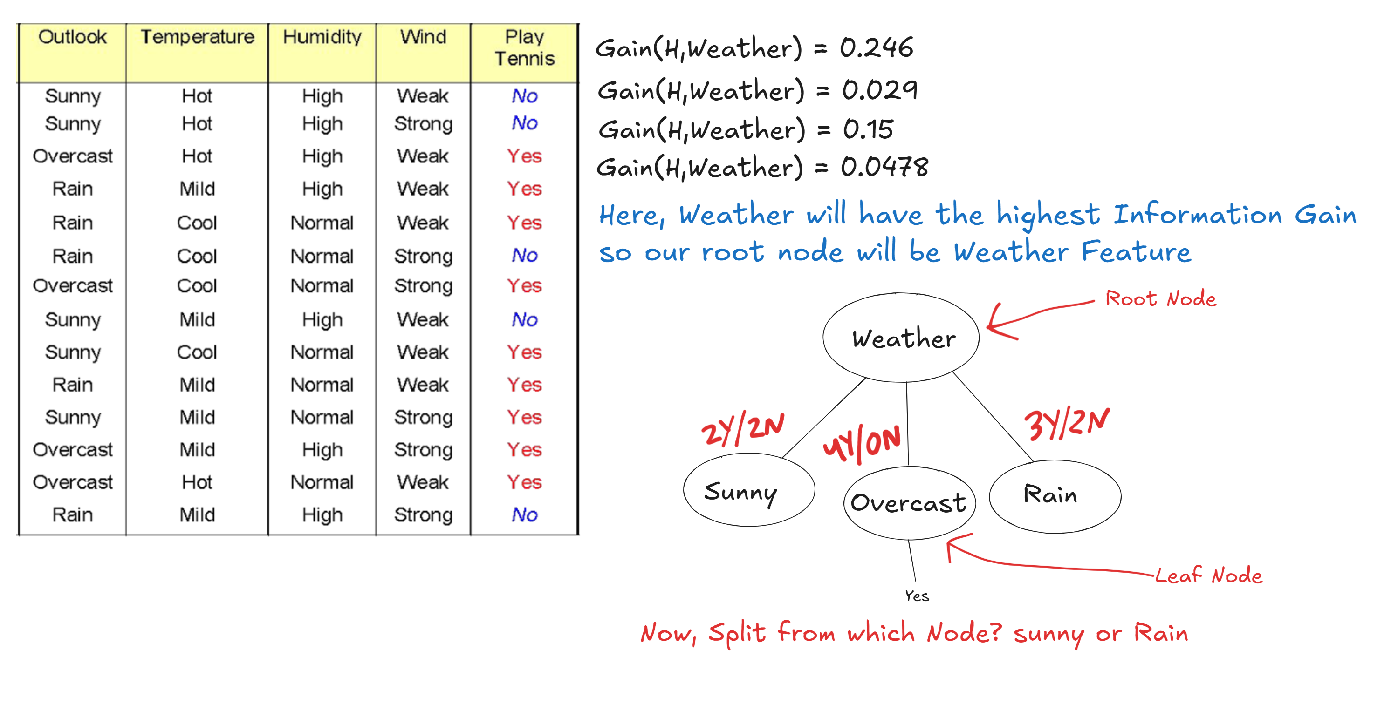

Slide 14
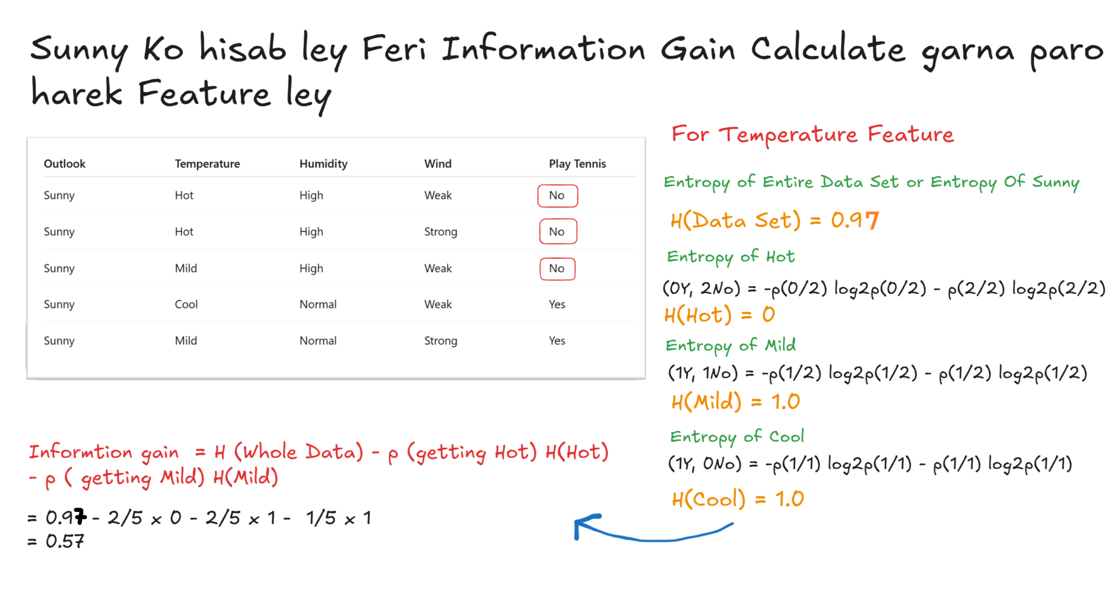

Slide 15
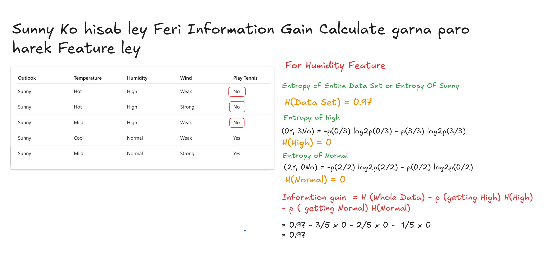

Slide 16
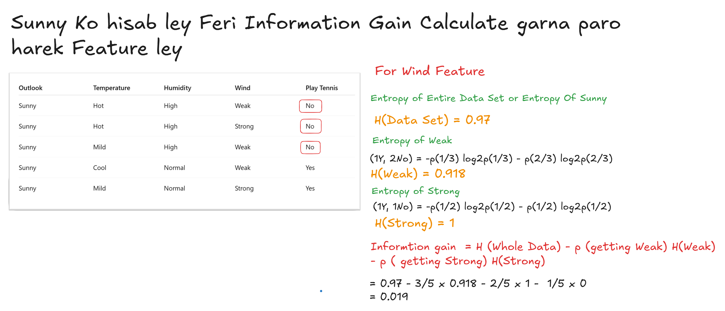

Slide 17
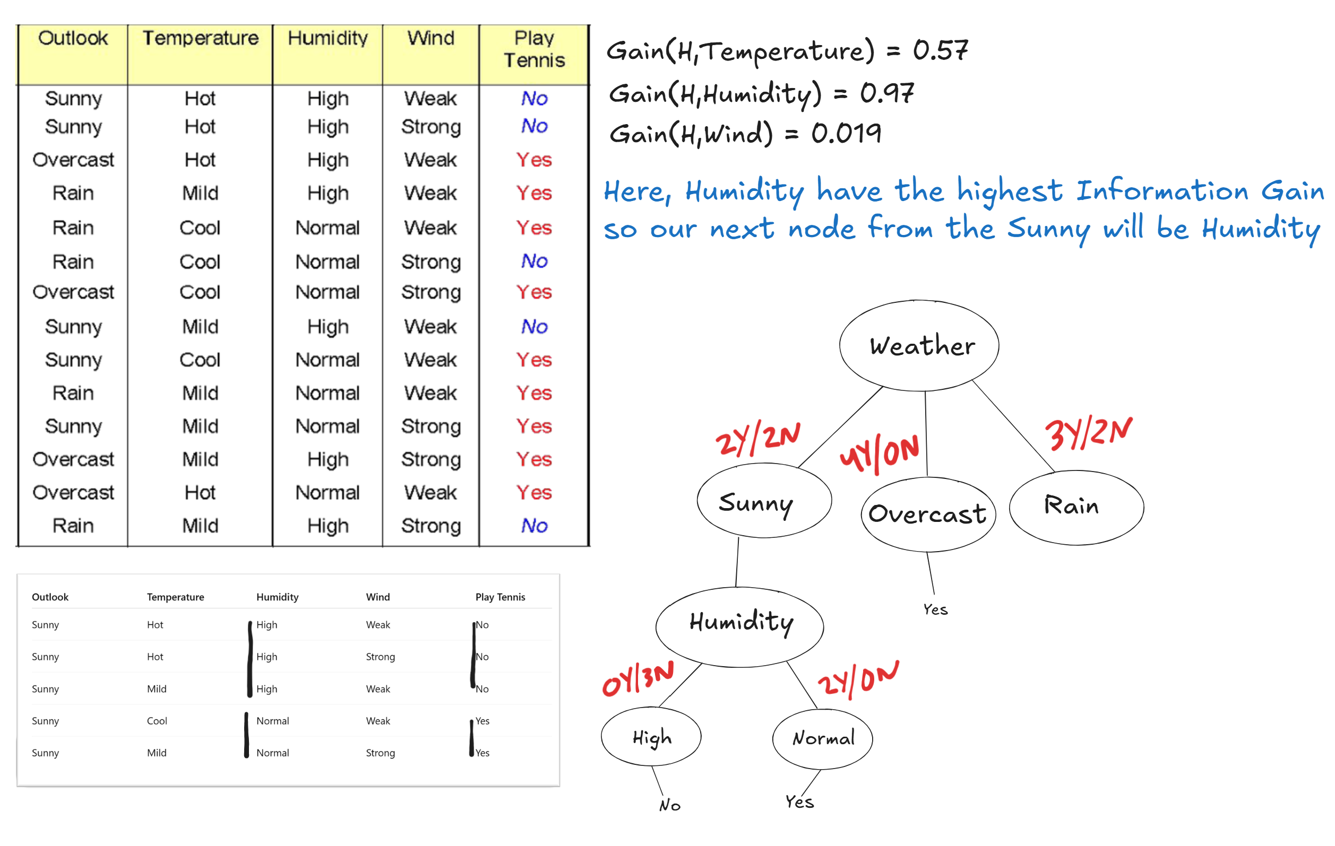

Slide 18
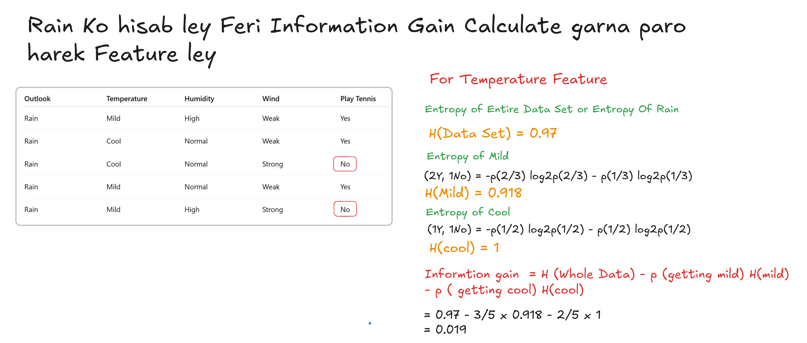

Slide 19
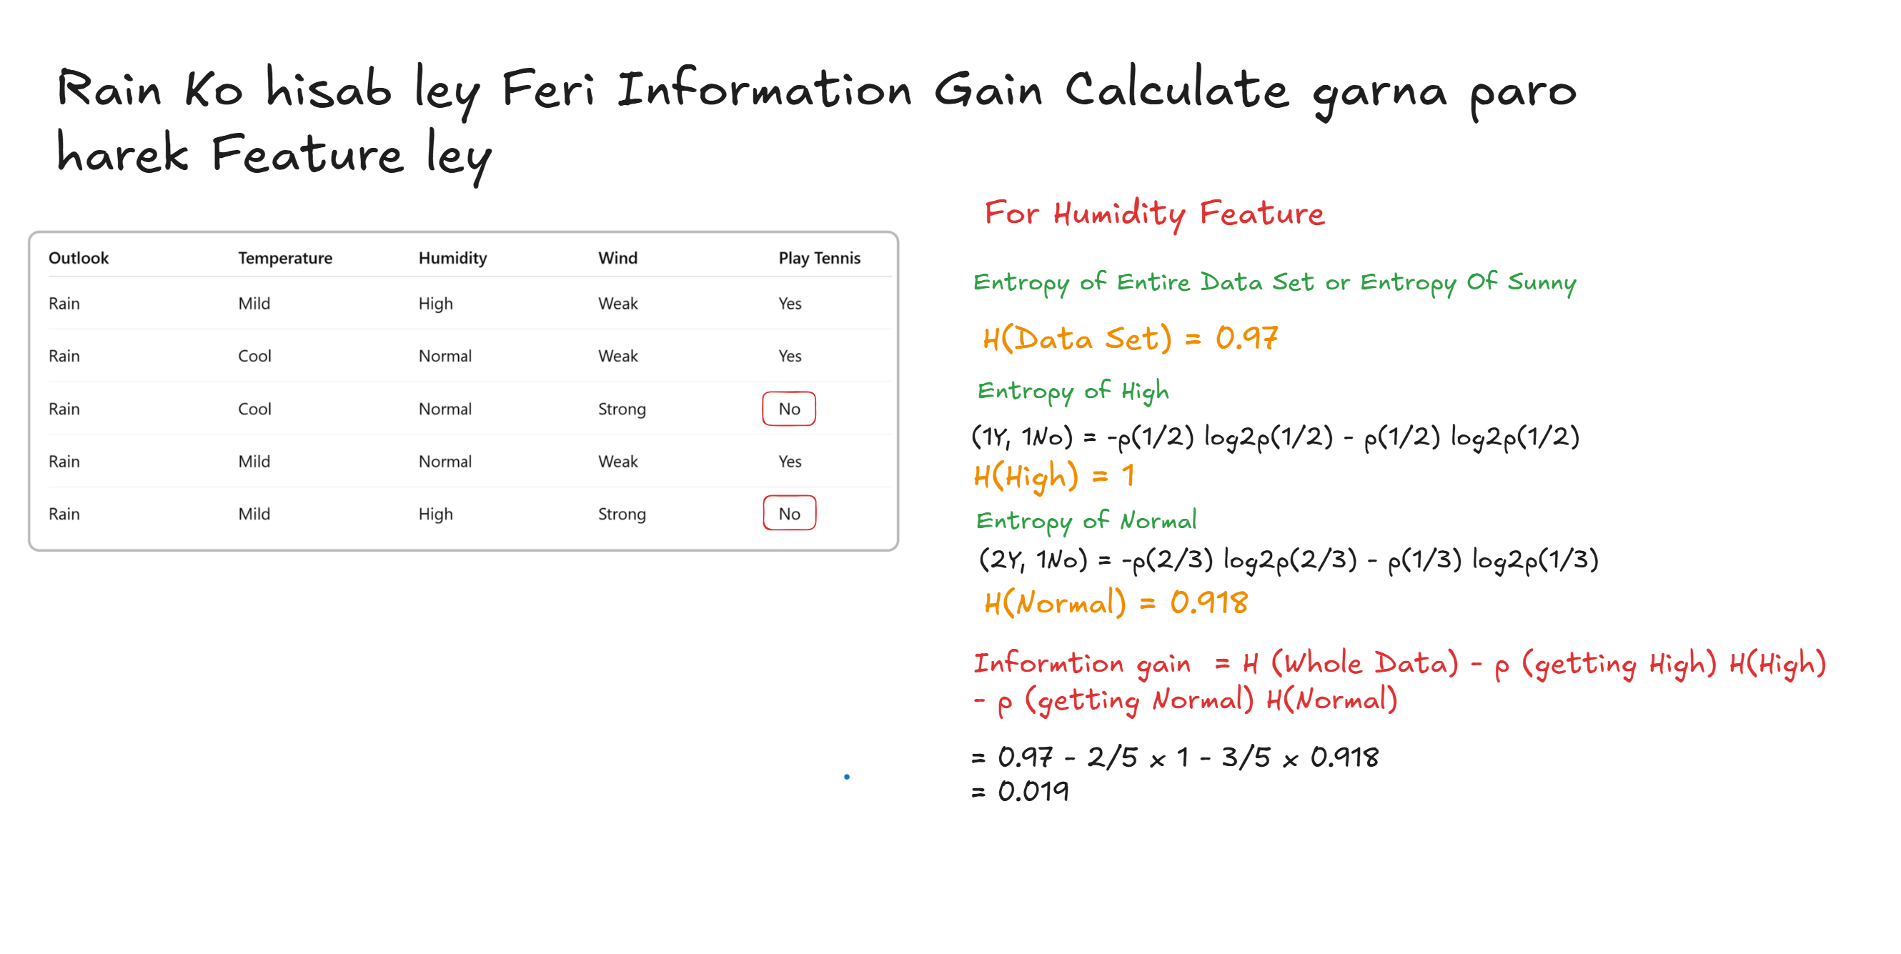

Slide 20
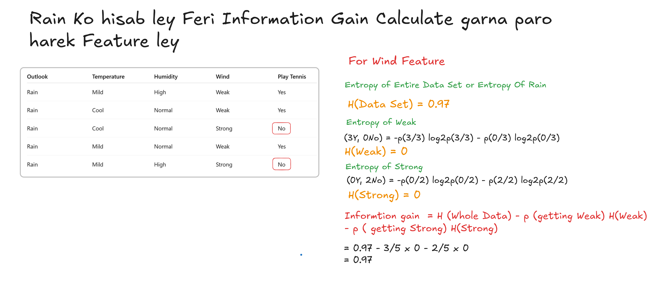

Slide 21
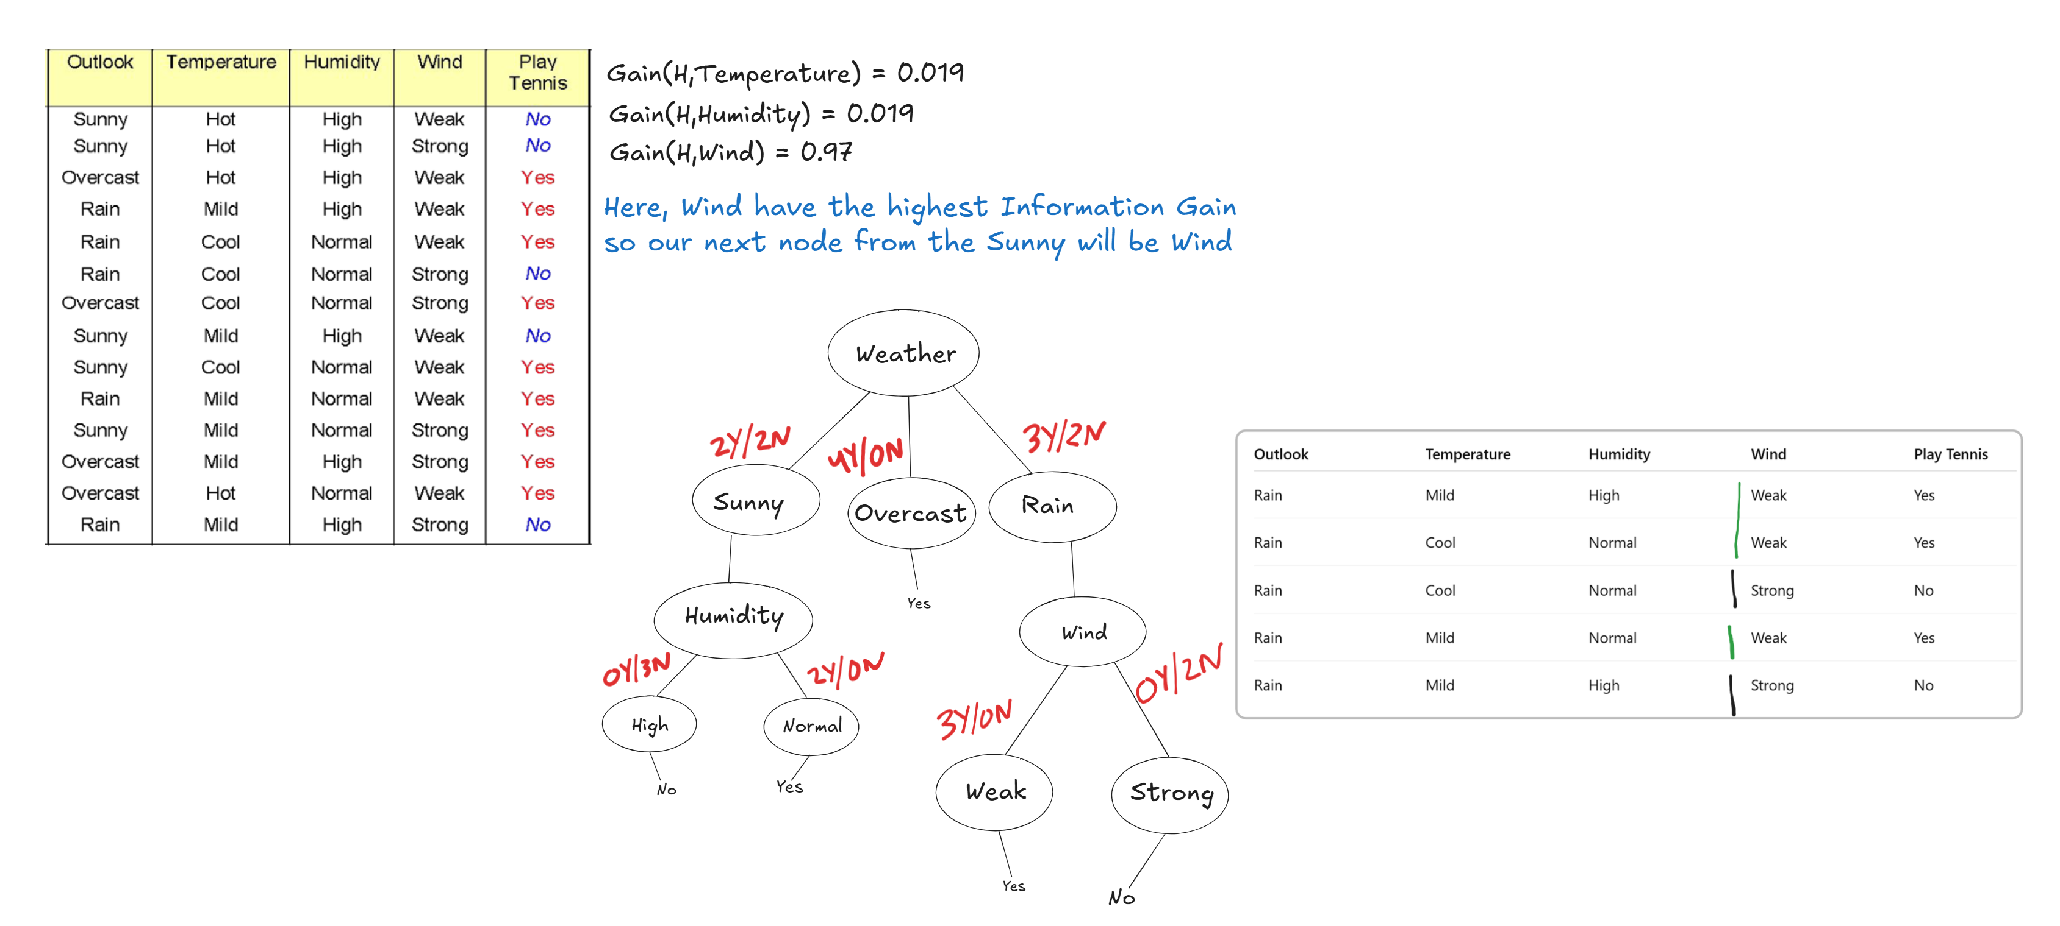

Slide 22
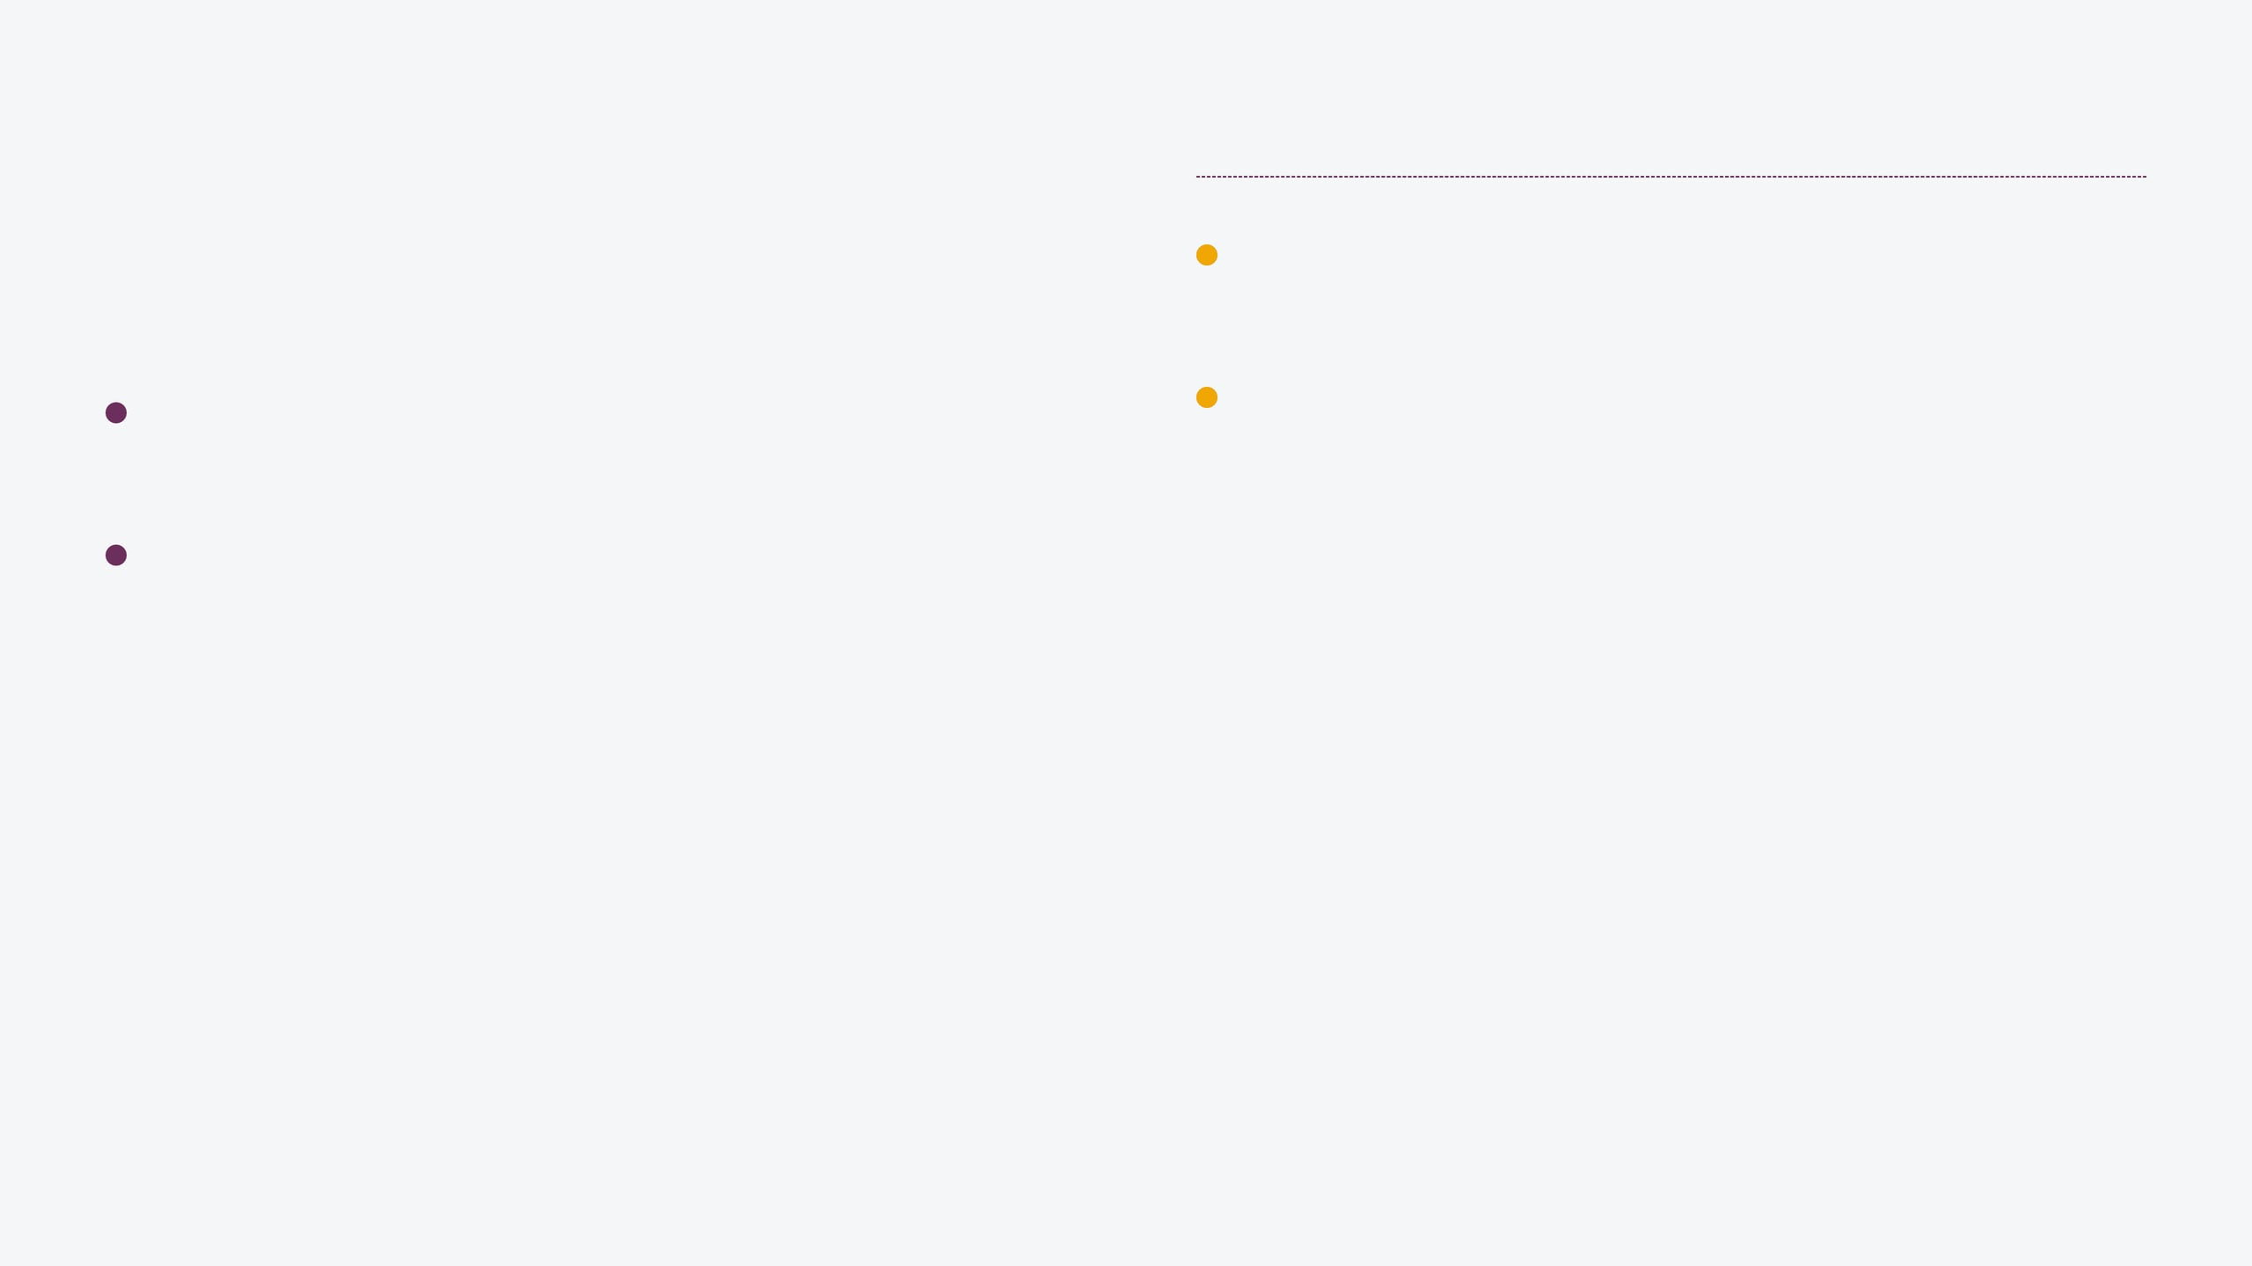
Decision trees can become "too deep," memorizing noise instead of learning general patterns.
Complexity: Every additional split increases the risk of creating branches for outliers.
Overfitting: Occurs when the tree perfectly classifies training data but fails on new, unseen data.
High Variance: Small changes in the training set can lead to drastically different tree structures.
Memorization vs. Learning: The model captures random fluctuations rather than the underlying distribution.
"A perfect score on training data is often a sign of a failed model."
The Challenge of Overfitting

Slide 23
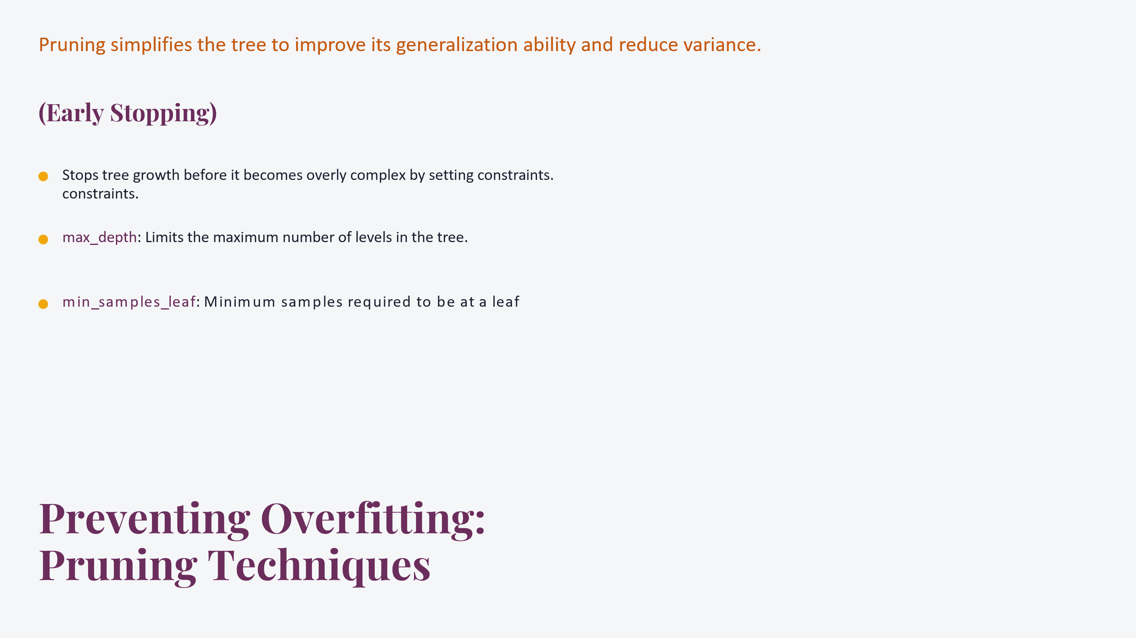

Slide 24
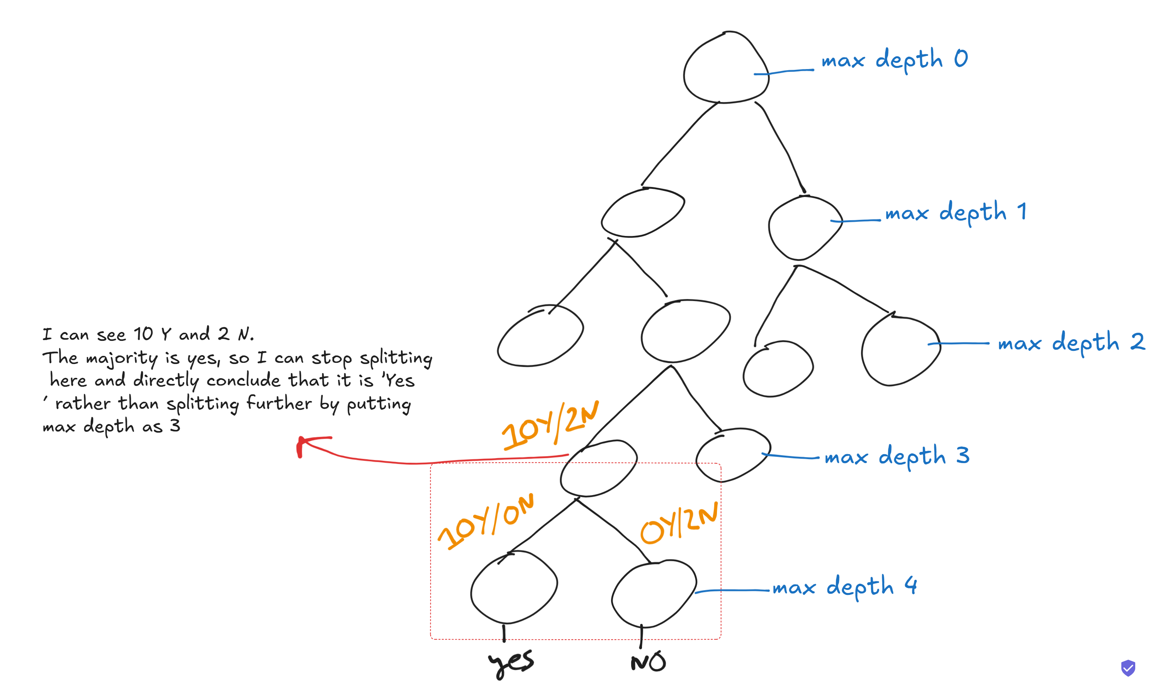
Max - Depth

Slide 25
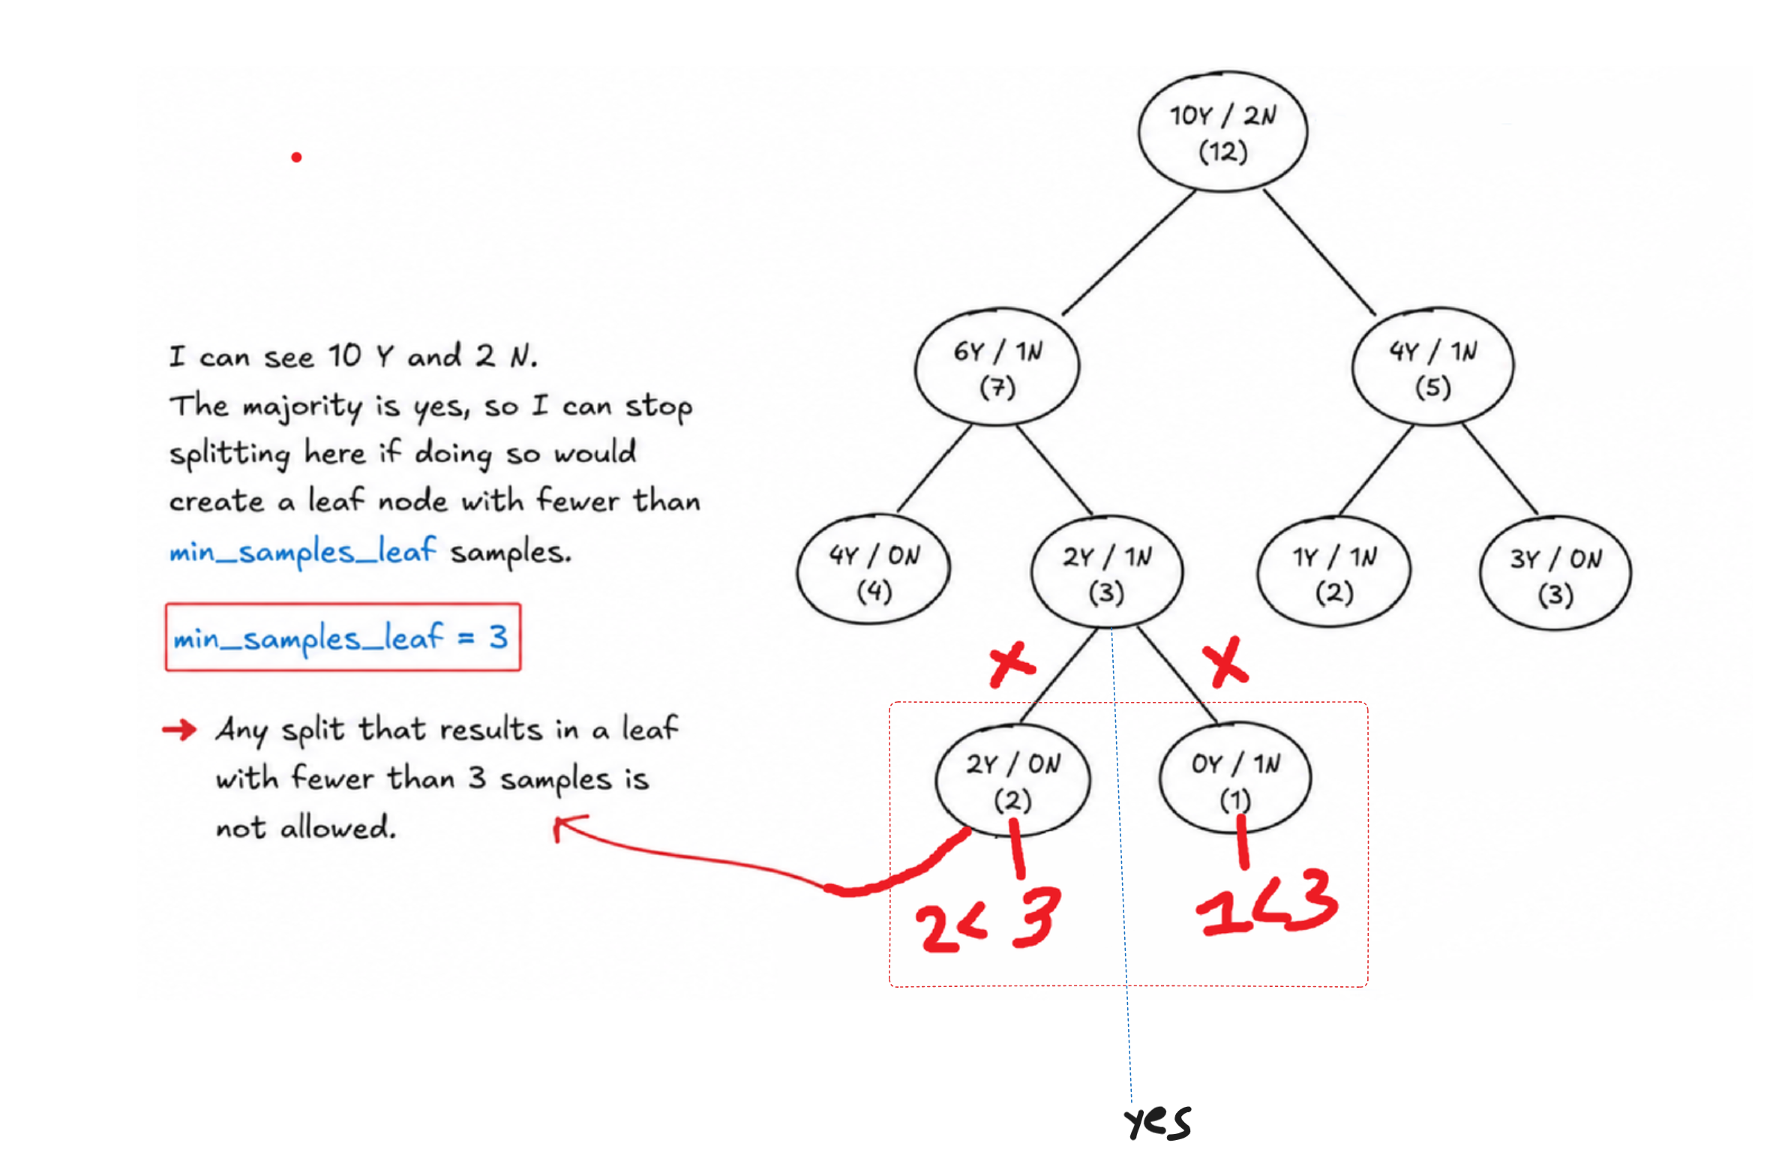
Min Sample Leaf

